Slide 1
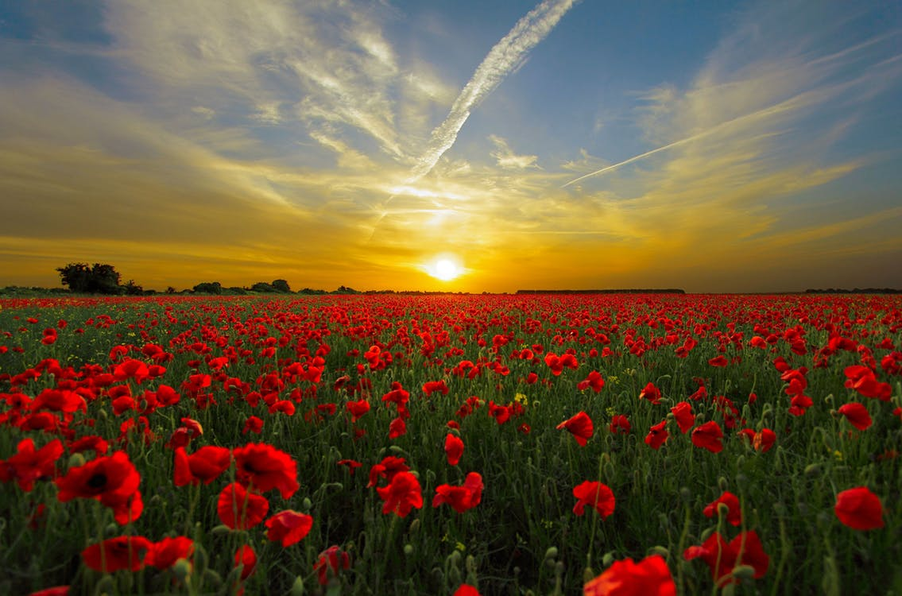
REMEMBERING ALL THE VETERANS
CHIEF PAYEPOT SCHOOL

Slide 2
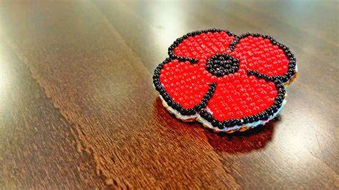
Aboriginal Veterans Day November 8.
Chief Payepot School
remembering on
November 10.
HONORING OUR ABORIGINAL VETERANS

Slide 3
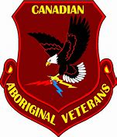
Our Piapot First Nations Veterans served in WW I, WW II and the Korean War. They made great contributions by using their Cultural knowledge and skills.
They were trackers, scouts, skilled marksman and snipers. They used their language as a secret code to defeat the enemy. They were code talkers. These Code Talkers were from all across the North American Continent of Canada and the USA.

Slide 4
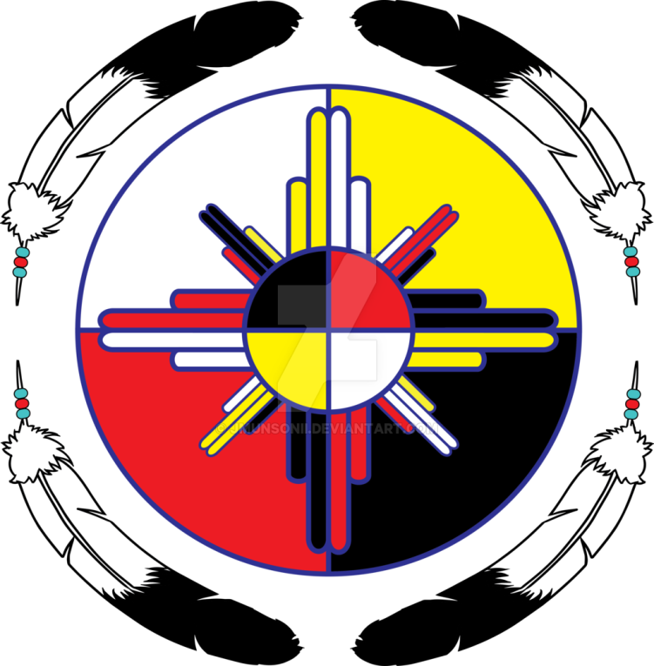
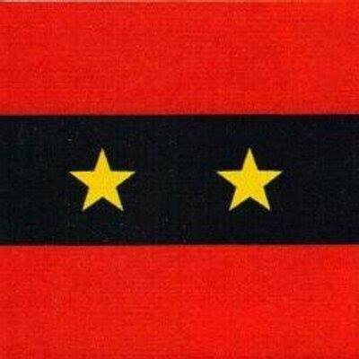
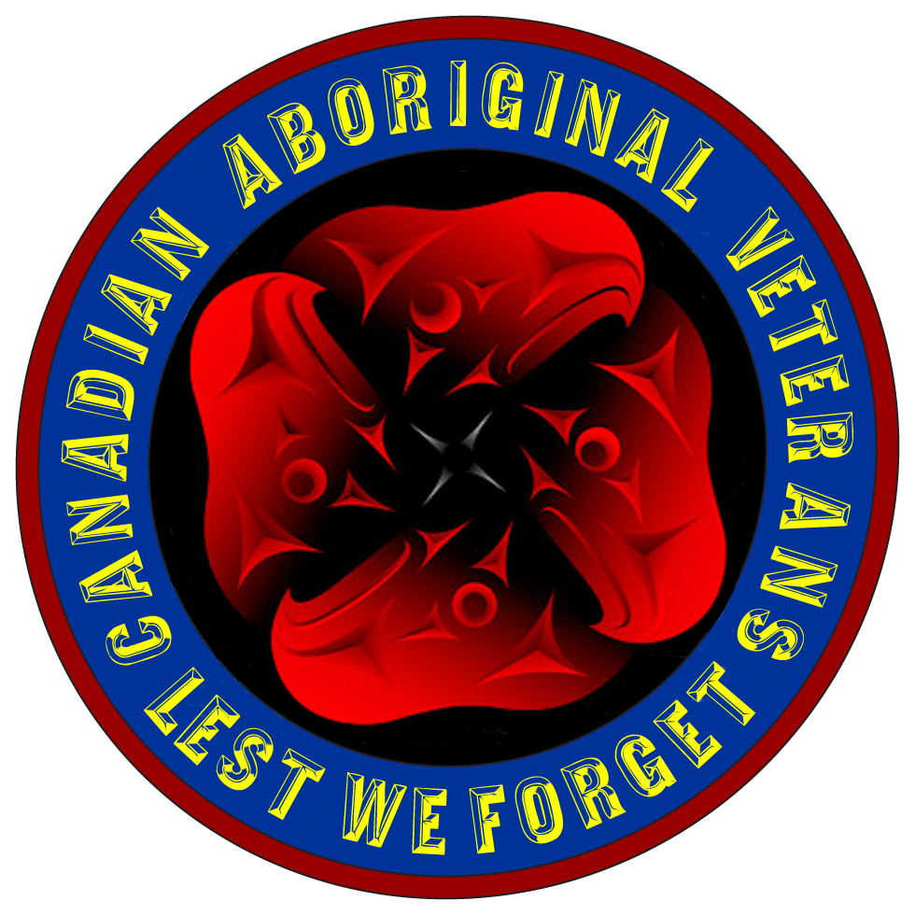
PIAPOT VETERANS
THE FOLLOWING ARE OUR PIAPOT VETERANS:

Slide 5
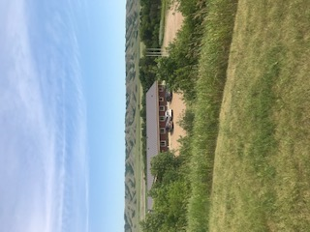
RODERICK ANASKAN PEACE TIME VETERAN

Slide 6
HARRY BALL WW I PIAPOT VETERAN

Slide 7
ALLAN CARRIER PEACE TIME VETERAN

Slide 8
WILFRED CARRIER
WW II PIAPOT VETERAN

Slide 9
BLAIR CARRIER
PEACETIME
VETERAN

Slide 10
ERNEST CROWE
WW II PIAPOT VETERAN

Slide 11
NOEL CROWE Sr.
WW II PIAPOT VETERAN

Slide 12
PAT GOPHER SR.
WW I PIAPOT VETERAN

Slide 13
EDDIE LAVALLEE PEACETIME NAVY VETERAN

Slide 14
ALBERT NONAME WW II PIAPOT VETERAN

Slide 15
GEORGE OBEY
WW II PIAPOT VETERAN

Slide 16
PETER PIAPOT WW II
USA FORCES

Slide 17
MIKE ROCKTHUNDER
KOREAN VETERAN

Slide 18
ABEL WATETCH WW I PIAPOT VETERAN

Slide 19
WILLIAM WESAQUATE
WW II ABORIGINAL CODE TALKER

Slide 20
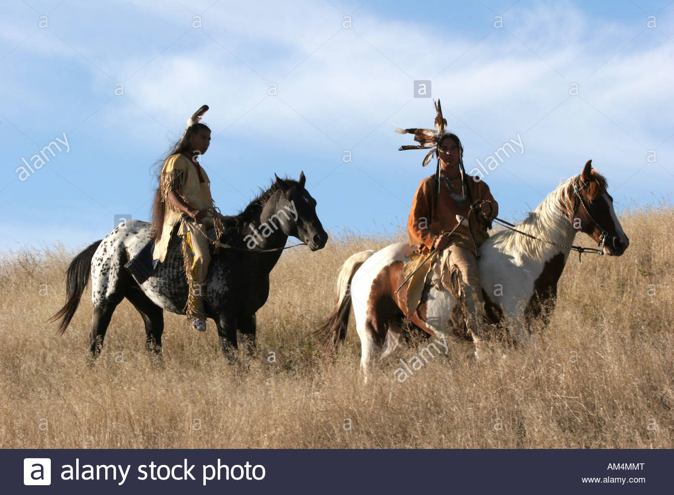
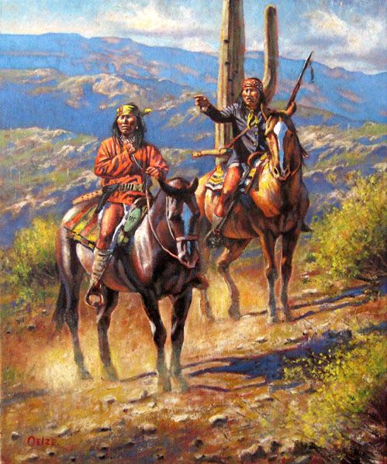

Slide 21
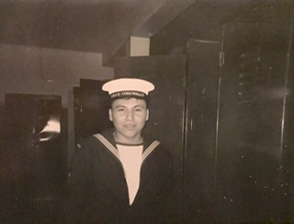
EDDIE LAVALLEE IN THE NAVY IN 1969 AT AGE 18
WARRIOR SONG SUNG BY
EDDIE LAVALLEE

Slide 22
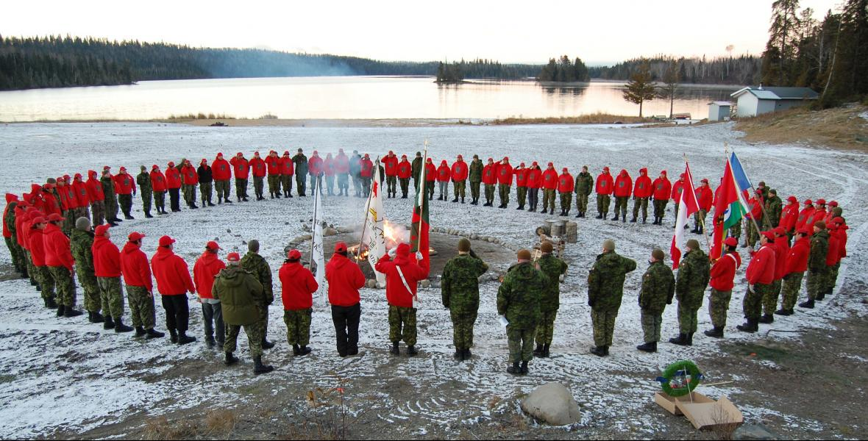
A MOMENT OF SILENCE TO HONOR OUR VETERANS

Slide 23
Thank you to Edward Lavallee for the Warrior song.
Thank you to Mikka McNab for Soldier Boy.

